Slide 1
Movie Revenue Analysis
By: Shrey Soni
Hanna Teshome
Ananya Jhamb

Slide 2
Our Purpose
Understand patterns and relationships in the film industry
Understand what drives success
Analyze audience preferences
Support decision-making for those who work in film
Notes:
Focusing on revenue, we look at age, budget, languages, release time, and more to try and solve these questions

Slide 3
Data Overview
movie_id:
Unique identifier for each movie.
title:
Title of the movie.
vote_average:
Average rating of the movie (e.g., from 0 to 10).
vote_count:
Total number of votes the movie has received.
status:
Status of the movie (e.g., "Released", "Planned").
release_date:
Release date of the movie.
revenue:
Total revenue generated by the movie.
adult:
Indicates if movie is for adults (true/false)
budget:
Budget for movie production.
imbd_id:
Unique identifier for the movie on IMDb.
original_language:
Language in which movie was originally produced:
original _title:
Original title of the movie (if different from the main title).
overview:
Brief summary or description of the movie
popularity:
Popularity score of the movie, often based on various factors.
genres:
Comma-separated list of genres associated with the movie.
production_companies:
Comma-separated list of companies that produced the movie.
production_countries:
Comma-separated list of countries where the movie was produced.
Spoken_languages: Comma-separated list of languages spoken in the movie.
Comma-separated list of languages spoken in the movie.

Slide 4
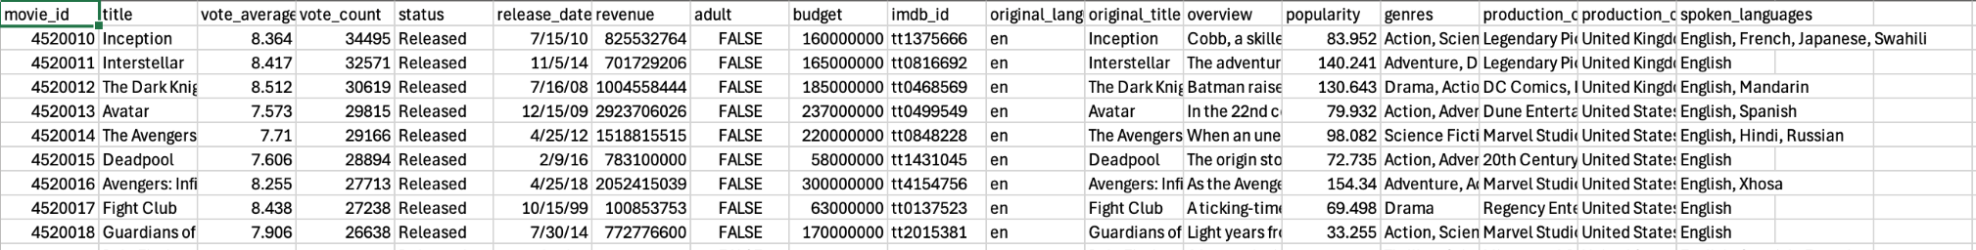
Data Overview

Slide 5
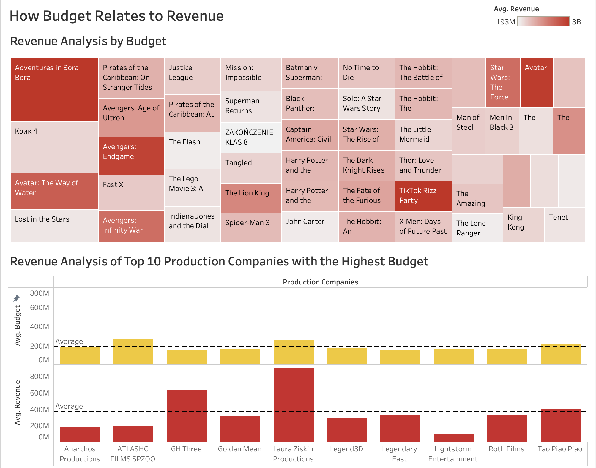
Dashboard 1
Tree Map:
Revenue → Color
Budget → Size
Marks → Square
The bigger and more pigmented the square the higher the revenue/budget
Bar Chart:
Created calculated field to split genre strings
Production companies → columns
Budget and revenue → rows
Added Average dotted line
Notes:
Tree map:

Slide 6
Findings
Higher budget leads to high revenue production
Not many films over sell their budget costs
Top 10 production companies often make three times as much of their revenue on average

Slide 7
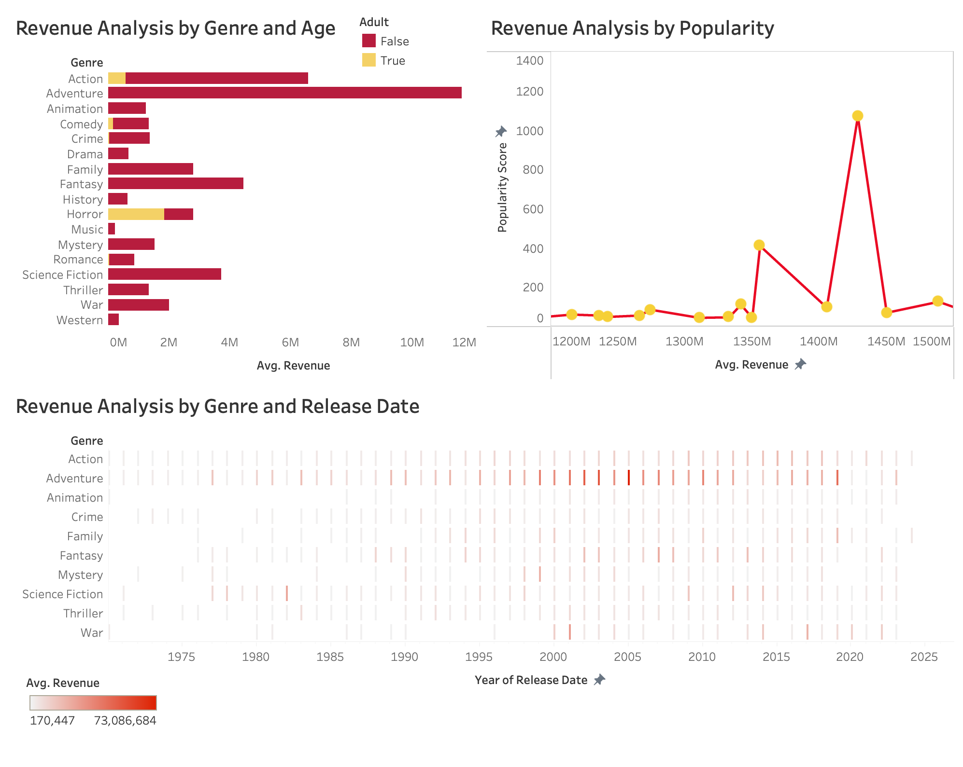
Dashboard 2
Stacked Bar-Chart:
Genre → Rows
Revenue → Columns
Adults → Color
Dual-Axis:
Revenue → columns
Popularity → rows x2 (one as a line chart another with circle chart)
Select dual axis
Heat Map:
Release date → columns (selected year)
Genre → rows
Revenue → colors

Slide 8
Findings
Adventure, action, and fantasy are the three genres with the highest grossings
Films that are for adults and children are much more profitable
Rise in popularity in film in more recent years
Popularity score is related to increase in revenue

Slide 9
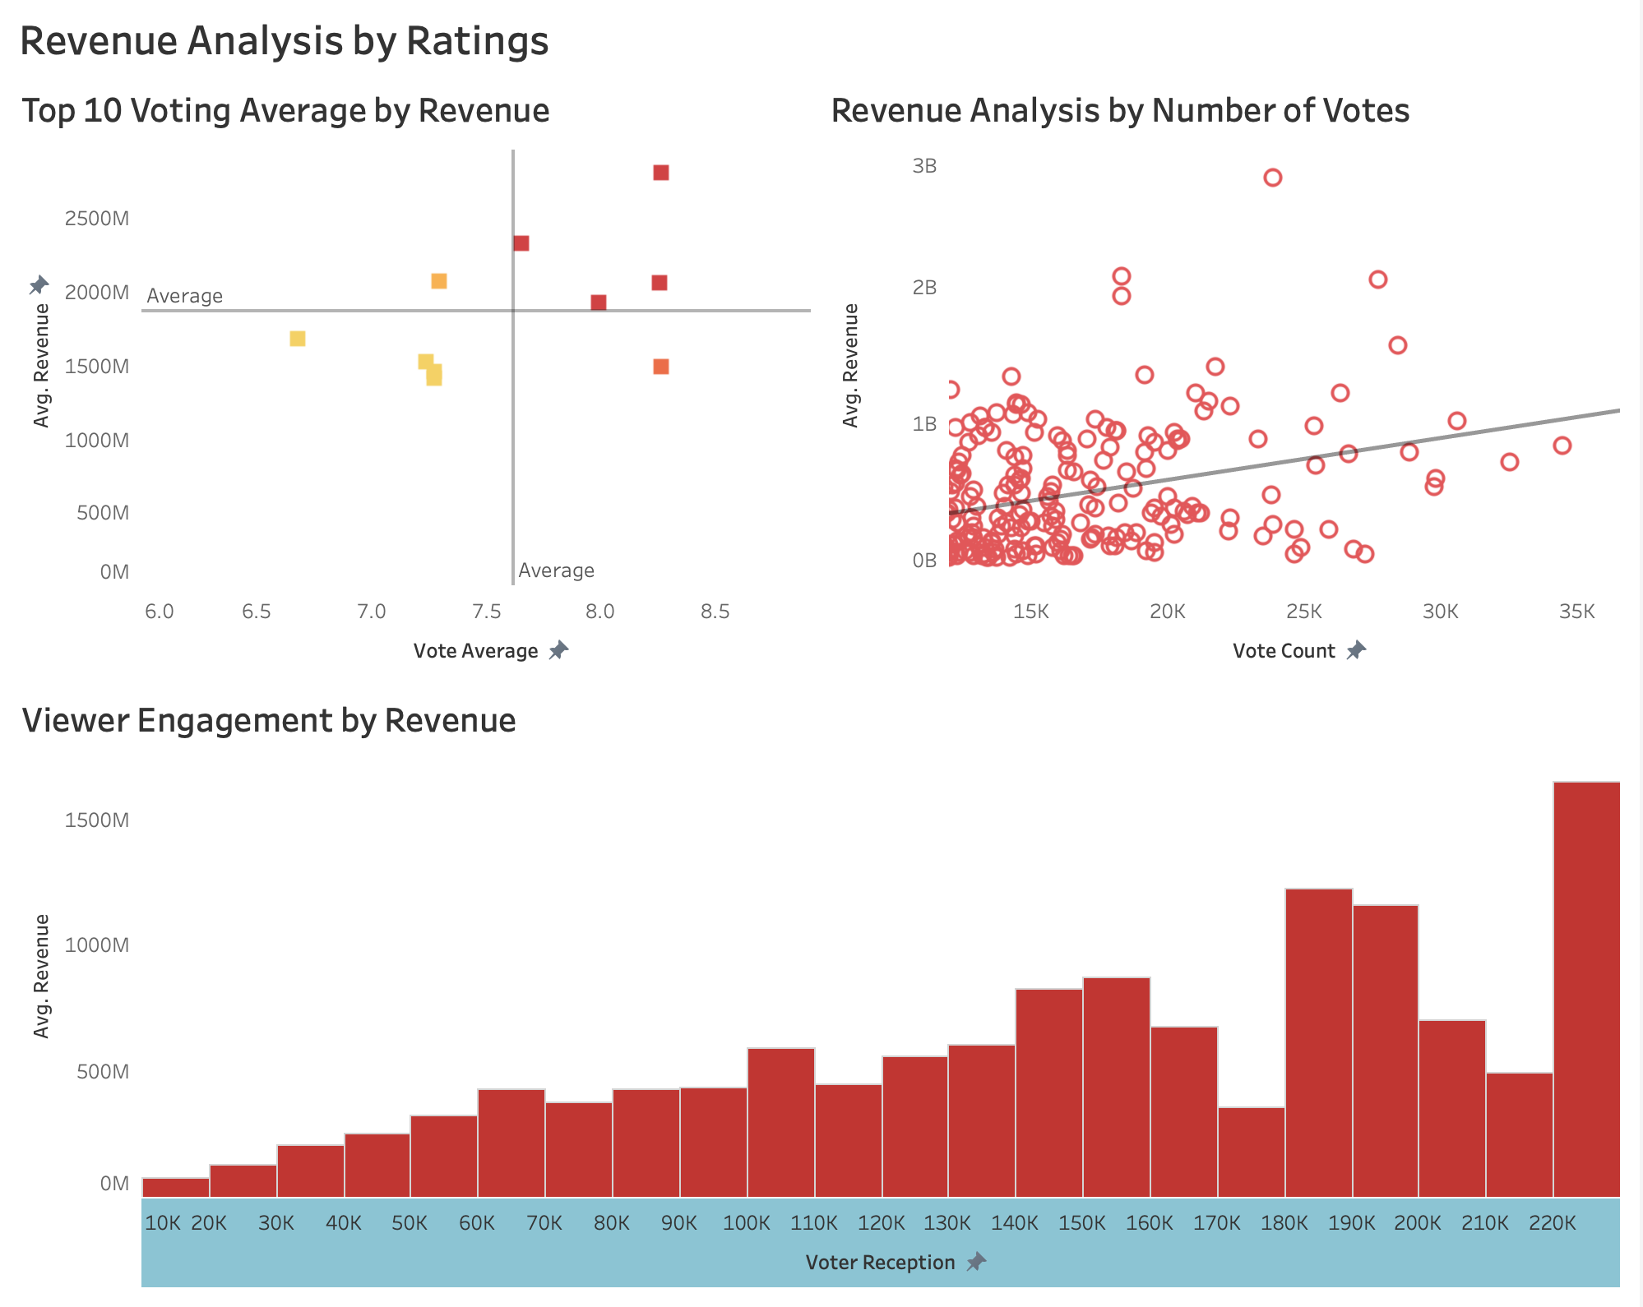
Dashboard 3
Clustering:
Filtered top 10 revenues
Voting avg. →columns
Revenue avg. → rows
Added two average lines
Clustered by quadrants
Scatter plot with a trend line:
Vote count → columns
Avg. revenue → rows
Filtered vote count
Bar Chart:
Created a calculated field called “voter reception” to analyze viewer engagement (vote count x vote score)
Voter reception →columns
Avg. revenue → rows

Slide 10
Findings
Movies with higher voting averages produce higher revenue
Number of votes is statistically significant to avg. revenue (p-value= <0.0001)
Higher viewer engagement leads to higher revenue

Slide 11
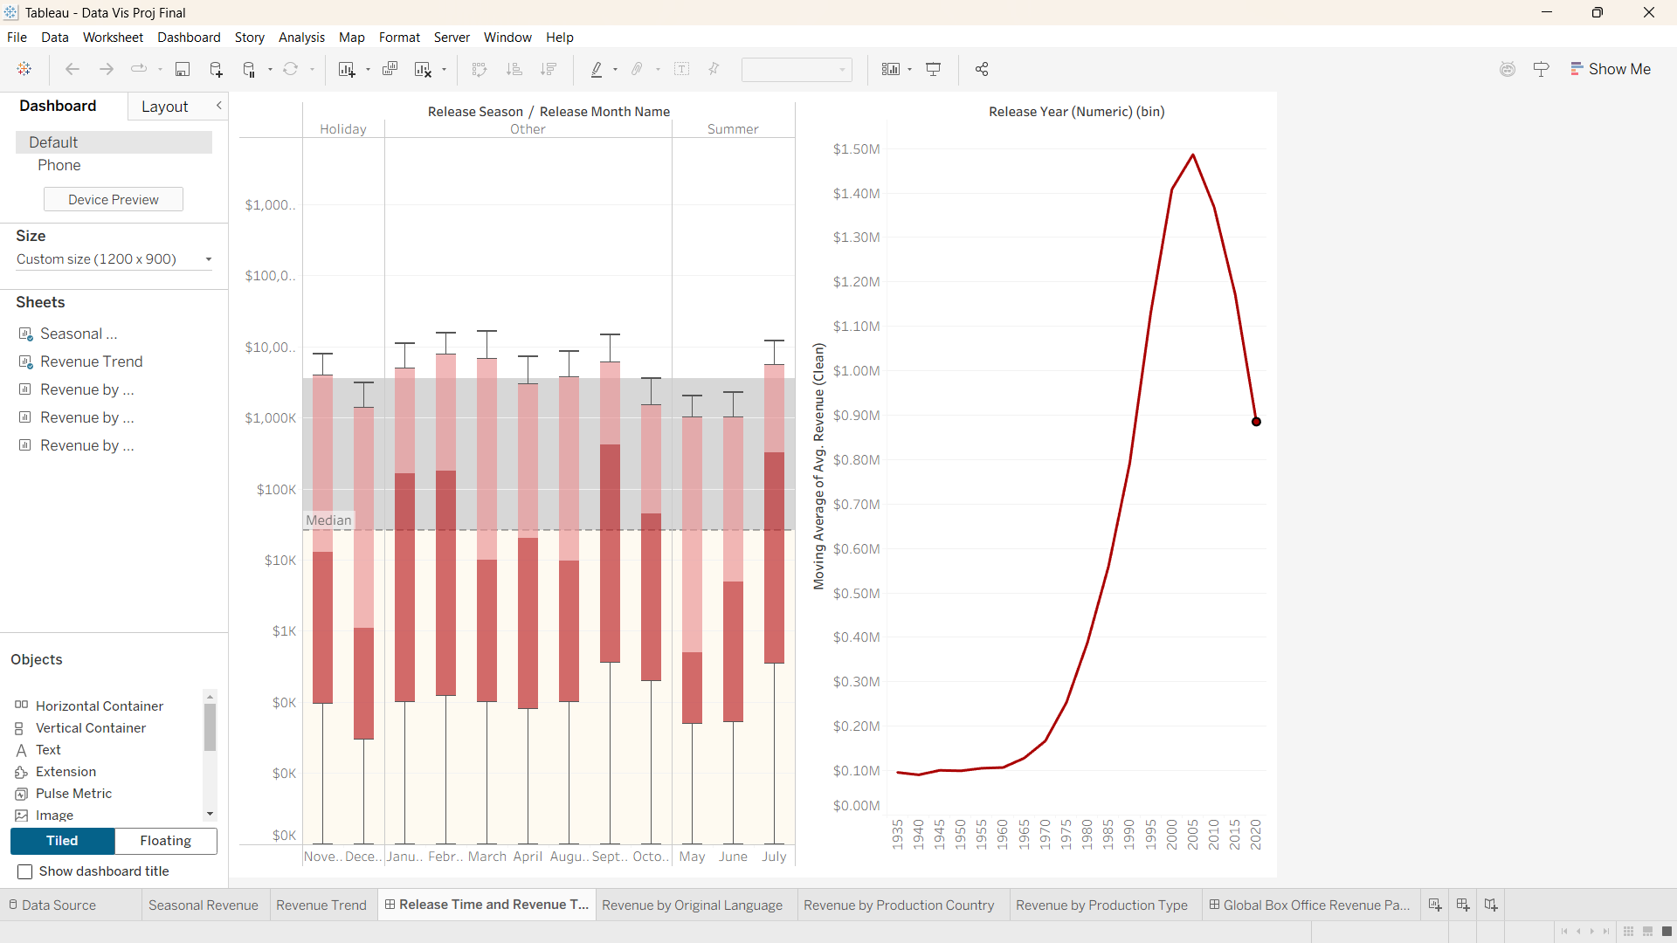
Seasonal Revenue Analysis
Revenue distribution plotted by release month, grouped into Holiday, Summer, and Other
Used box plots to capture spread, median, and outliers
Added overall median reference line for comparison across months
Revenue Trend Over Time
Release Year (binned) plotted against moving average of average revenue
Applied a smoothed trend line to reduce volatility and highlight long-term patterns

Slide 12
Findings
Movies released during holiday and peak summer months tend to generate higher median revenues compared to off-season releases.
Revenue growth shows a strong upward trend from the late 1980s through early 2000s, indicating industry expansion and higher box-office potential over time.
Recent years show greater volatility and slight decline, suggesting market saturation and increased competition from alternative distribution platforms.

Slide 13

Revenue by Production Type
Compared average revenue across single-country productions and international co-productions
Used a horizontal bar chart for direct revenue comparison
Revenue by Original Language
Visualized revenue share by original language using a pie chart
Highlighted dominance of English-language films relative to other languages
Revenue by Production Country
Displayed total revenue by production country using a world heat map
Color intensity represents cumulative box office performance across regions

Slide 14
Findings
International co-productions generate significantly higher average revenue than single-country productions, indicating benefits from cross-border financing and market access.
English-language films dominate global box office revenue, accounting for the majority of total revenue compared to non-English productions.
Box office revenue is highly concentrated in a small number of countries, with the United States and select international markets contributing disproportionately to global earnings.

Slide 15
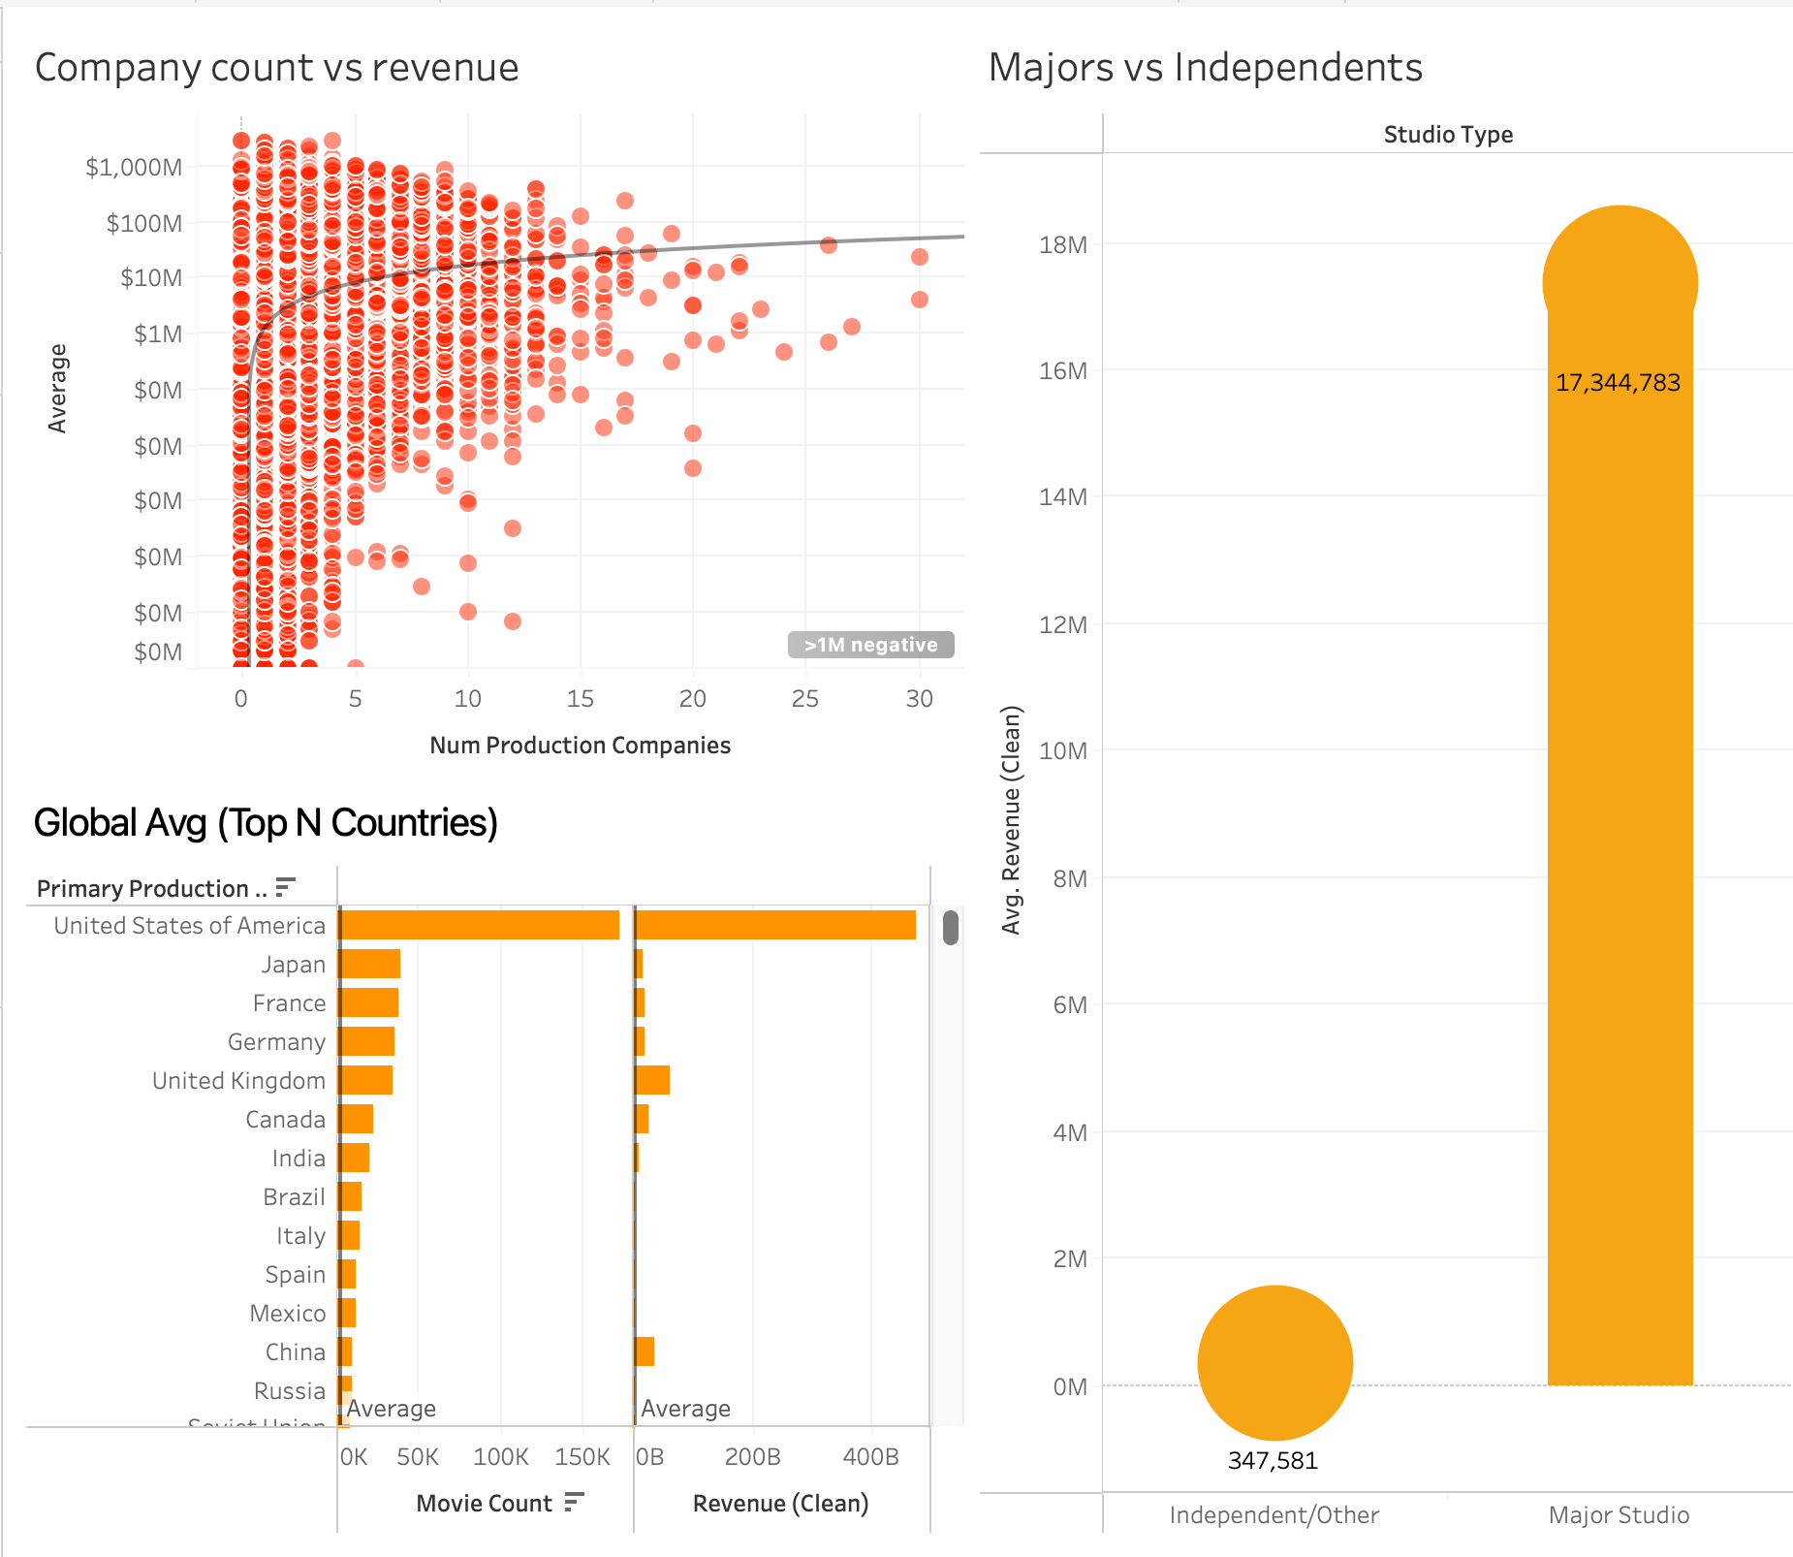
Dashboard 4
Company Count Vs revenue
Majors vs independents
Global Average of Top N countries
Notes:
Industry structure matters. Revenue outcomes are strongly influenced by studio type, scale of production collaboration, and country concentration, with major studios and U.S.-based productions dominating global box office performance.
The scatter plot shows a weak but positive relationship between the number of production companies involved in a film and its revenue.
Most movies are produced by 1–5 companies, and these exhibit wide revenue dispersion, including both low- and high-performing films.
Movies involving larger production consortia (10+ companies) tend to achieve higher average revenues, suggesting benefits from pooled resources, risk sharing, and broader distribution access.
However, variance remains high, indicating that collaboration alone does not guarantee success.
The scatter plot shows a weak but positive relationship between the number of production companies involved in a film and its revenue.
Most movies are produced by 1–5 companies, and these exhibit wide revenue dispersion, including both low- and high-performing films.
Movies involving larger production consortia (10+ companies) tend to achieve higher average revenues, suggesting benefits from pooled resources, risk sharing, and broader distribution access.
However, variance remains high, indicating that collaboration alone does not guarantee success.
The country analysis highlights strong geographic concentration in film production and revenue:
The United States overwhelmingly leads in both movie count and total revenue, reinforcing its central role in the global film industry.
Other major producers (Japan, France, UK, Germany) contribute meaningfully but at significantly lower revenue scales.
Emerging markets show production activity but limited revenue impact, indicating unequal access to global distribution and monetization.
demonstrates that revenue is not evenly distributed across the film industry. Instead, it is concentrated among:
major studios,
high-collaboration productions, and
U.S.-centric production ecosystems.
This structural imbalance helps explain why a small subset of films captures a disproportionate share of global box office revenue.

Slide 16
Findings
It demonstrates that revenue is not evenly distributed across the film industry. Instead, it is concentrated among:
major studios,
high-collaboration productions, and
U.S.-centric production ecosystems.
This structural imbalance helps explain why a small subset of films captures a disproportionate share of global box office revenue.

Slide 17
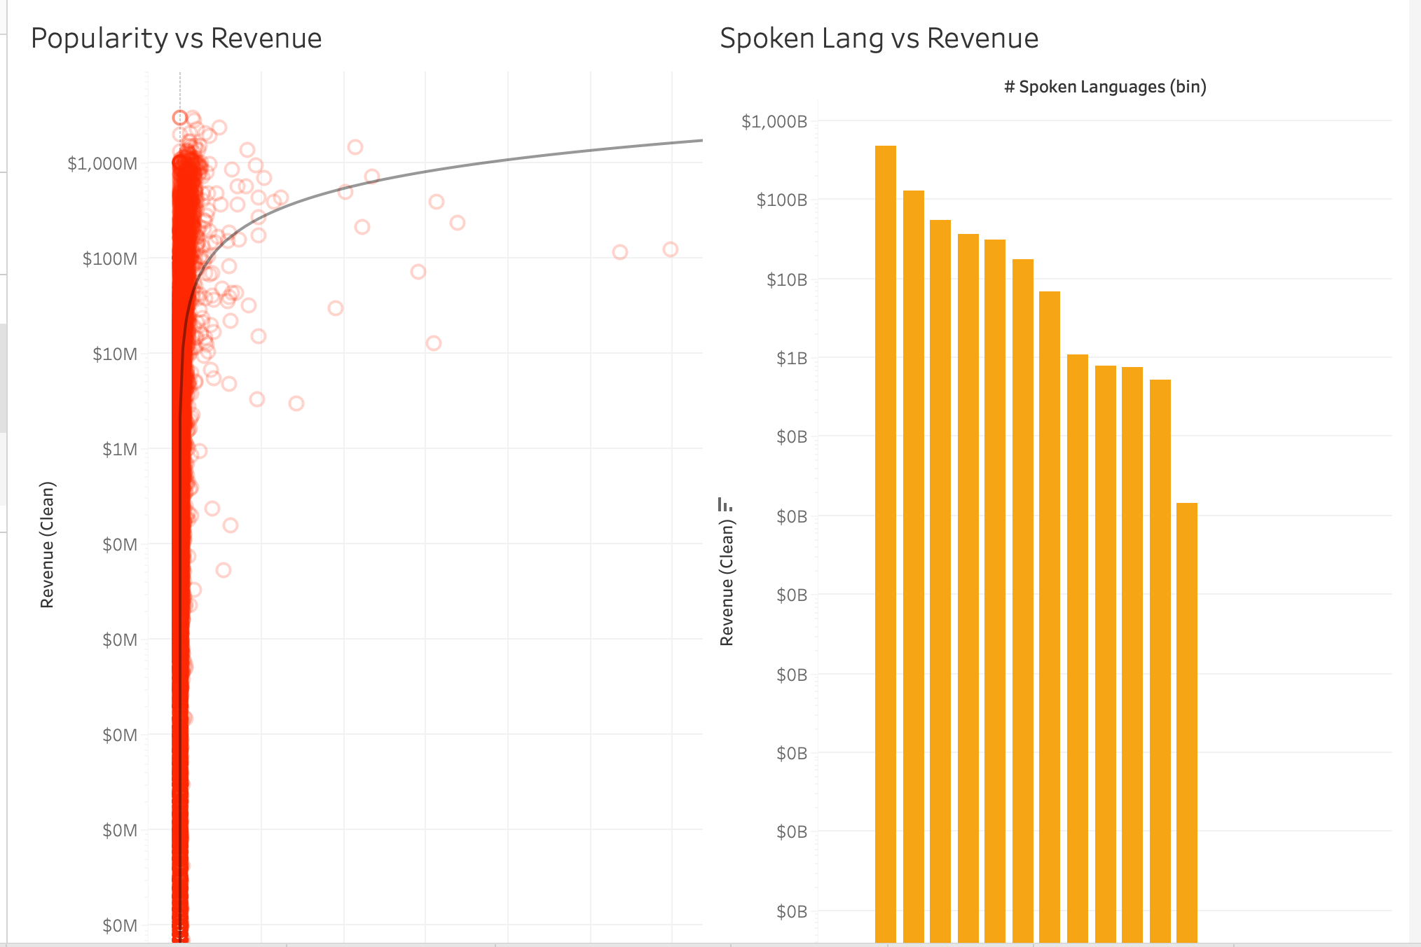
Dashboard 5
Popularity vs Revenue
Spoken languages vs revenue
Notes:
Pre-release popularity is strongly associated with higher revenue, while increasing the number of spoken languages does not guarantee higher box office performance and may reflect market fragmentation rather than global reach.
Pre-release popularity is strongly associated with higher revenue, while increasing the number of spoken languages does not guarantee higher box office performance and may reflect market fragmentation rather than global reach.
The bar chart bins movies by the number of spoken languages and compares total revenue.
Movies with fewer spoken languages (1–2) account for the largest share of total revenue.
As the number of spoken languages increases, total revenue declines steadily.
Multilingual films are far less common and do not consistently outperform single-language productions.
Spoken Languages vs Revenue
The bar chart bins movies by the number of spoken languages and compares total revenue.
Movies with fewer spoken languages (1–2) account for the largest share of total revenue.
As the number of spoken languages increases, total revenue declines steadily.
Multilingual films are far less common and do not consistently outperform single-language productions.
This suggests that adding spoken languages may reflect local adaptations or niche targeting, rather than a strategy that reliably increases global revenue.
This suggests that adding spoken languages may reflect local adaptations or niche targeting, rather than a strategy that reliably increases global revenue.
that demand signals matter more than breadth signals:
Popularity is a strong and consistent predictor of higher revenue.
Language diversification alone does not translate into commercial success and may dilute focus rather than expand market reach.
Together, these results indicate that effective marketing and audience anticipation outweigh content localization in driving box office outcomes.

Slide 18
Findings
It shows that demand signals matter more than breadth signals:
Popularity is a strong and consistent predictor of higher revenue.
Language diversification alone does not translate into commercial success and may dilute focus rather than expand market reach.
Together, these results indicate that effective marketing and audience anticipation outweigh content localization in driving box office outcomes.

Slide 19
Conclusion
Movie box office performance is driven by a combination of budget, release timing, production strategy, and audience engagement, rather than any single factor.
Higher budgets generally lead to higher revenues, but profitability varies widely, indicating that budget alone is not a reliable predictor of success.
Movies released during summer and holiday seasons consistently earn more revenue, highlighting the importance of strategic release timing.
International co-productions, English-language films, and productions from major markets tend to dominate global revenue, reflecting the value of broader market reach.
Audience engagement—measured through ratings, vote counts, popularity, and overall reception—shows a strong positive relationship with revenue.
Overall, successful films align financial investment, global accessibility, and strong audience response, reinforcing the need for data-driven decision-making in the movie industry.

Slide 20
Sources
https://www.kaggle.com/datasets/mohammedalsubaie/movies?resource=download

Slide 21
Tableau Link
https://public.tableau.com/app/profile/shrey.soni7744/viz/shared/K686Z563Y

Slide 22
Thank You!

